Slide 1

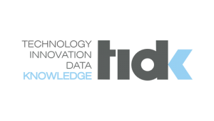

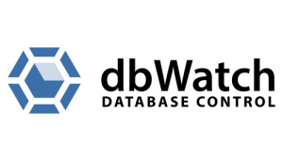





GOLD SPONSORS
SILVER SPONSORS
BRONZE SPONSOR
STRATEGIC PARTNER

Slide 2
Get data insights faster with Data Wrangling
Sergiy Lunyakin

Slide 3




About me
SERGIY LUNYAKIN
Big Data Architect at SoftServe Inc
Center of Excellence – Intelligent Enterprise
MS Data Platform MVP, MCSE Data Analytics, MCSA Cloud Platform

Slide 4
Agenda
What is Data Wrangling
Place of Data Wrangling
Data Wrangling Drivers
ETL or Data Wrangling
Trifacta
Demo

Slide 5
What is Data Wrangling?
Data Wrangling is the process of cleaning, structuring and enriching raw data into a desired output for analysis
Data Wrangling
Question
Analyze
Insight
Discover
Refine
Publish
Q&A
80 %
20 %

Slide 6
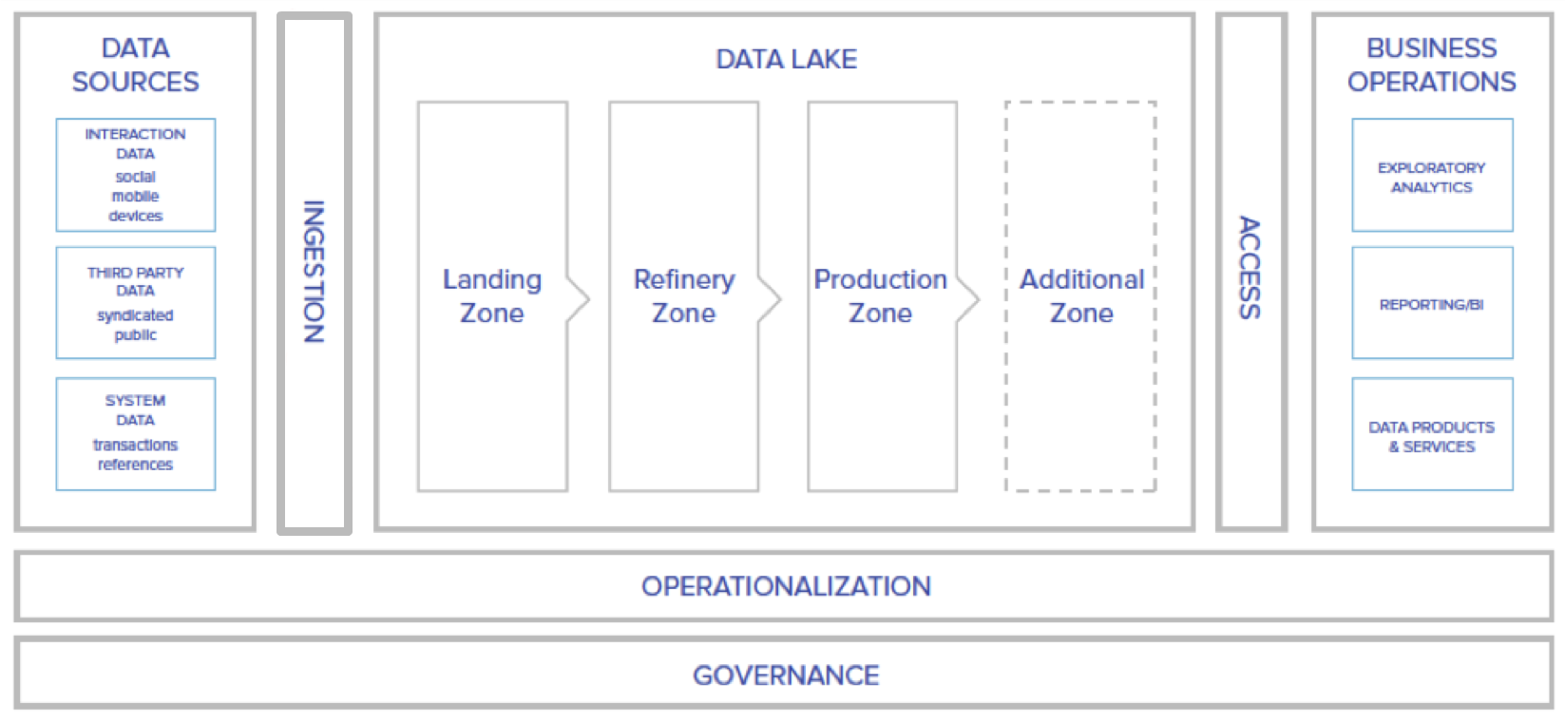
Place of Data Wrangling
Data Wrangling

Slide 7
Data Wrangling Drivers
81% Shorten time to business insight
76% Increase data-driven decision making
53% Improve reaction time to business conditions
49% Operational efficiency for frontline works
43% Gain a single, complete view of relevant data
* According to a TDWI’s Best Practices Report on “Improving Data Preparation for Business Analytics”

Slide 8
ETL or Data Wrangling
Traditional (ETL) | Data Wrangling
Done by IT | Done by data analysts, data scientists, power users
Enterprise reporting | Exploratory projects, Data Discovery, Prototyping
Long-term projects | Quick wins
Data Standards | Little documentation and governance
Metadata & Governance | Detailing ETL Requirements, Precursor to ETL build

Slide 9
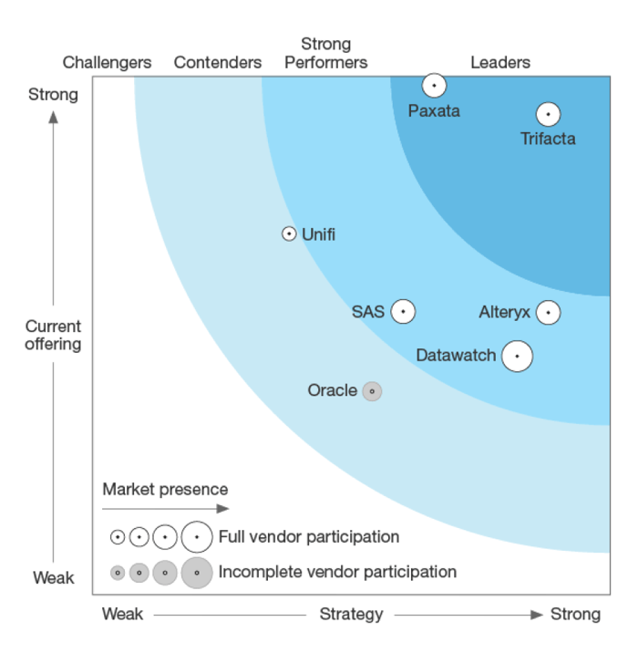
Choosing a Data Wrangling Tool
Forrester Wave™: Data Preparation Tools, Q1 2017

Slide 10


Slide 11
What is Trifacta?
“Trifacta is the global leader in data wrangling software, significantly enhances the value of an enterprise’s big data by enabling users to easily transform and enrich raw, complex data into clean and structured formats for analysis”
by Gartner Data & Analytics Summit 2017

Slide 12
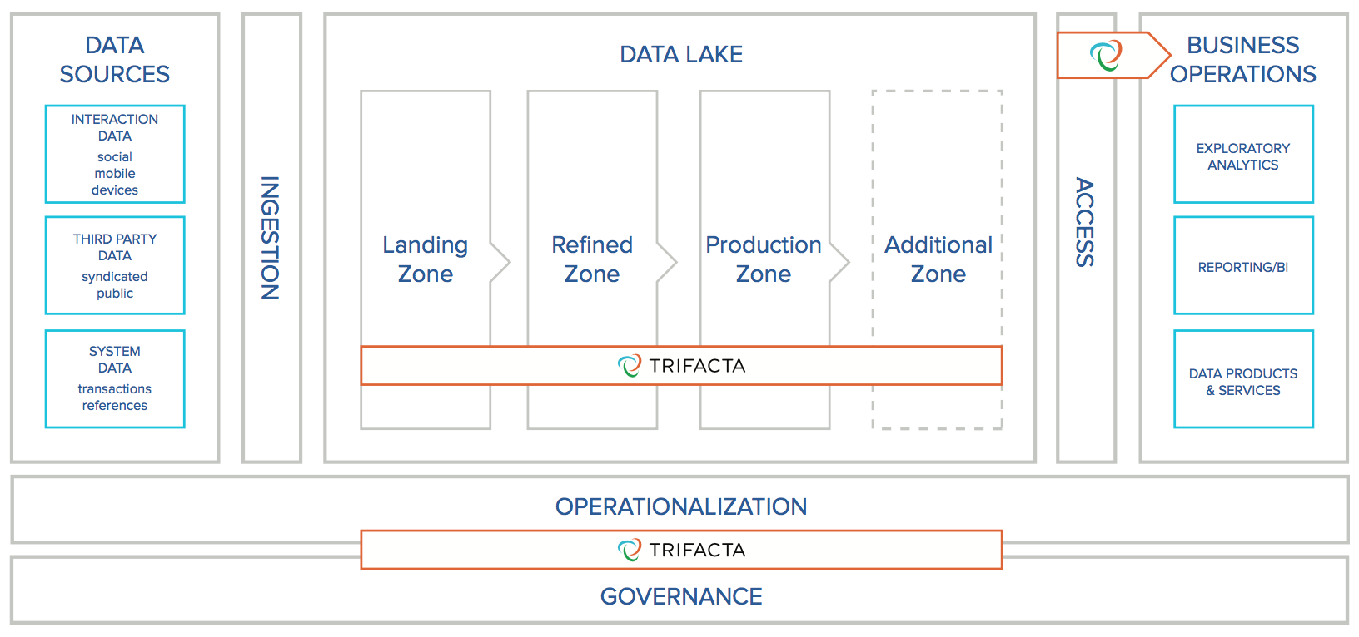
Situating in Data Lake

Slide 13
Common Data Wrangling Use Cases with Trifacta
Self-Service data prep. automation
Preparation for IT Operationalization
Exploratory Analytics

Slide 14
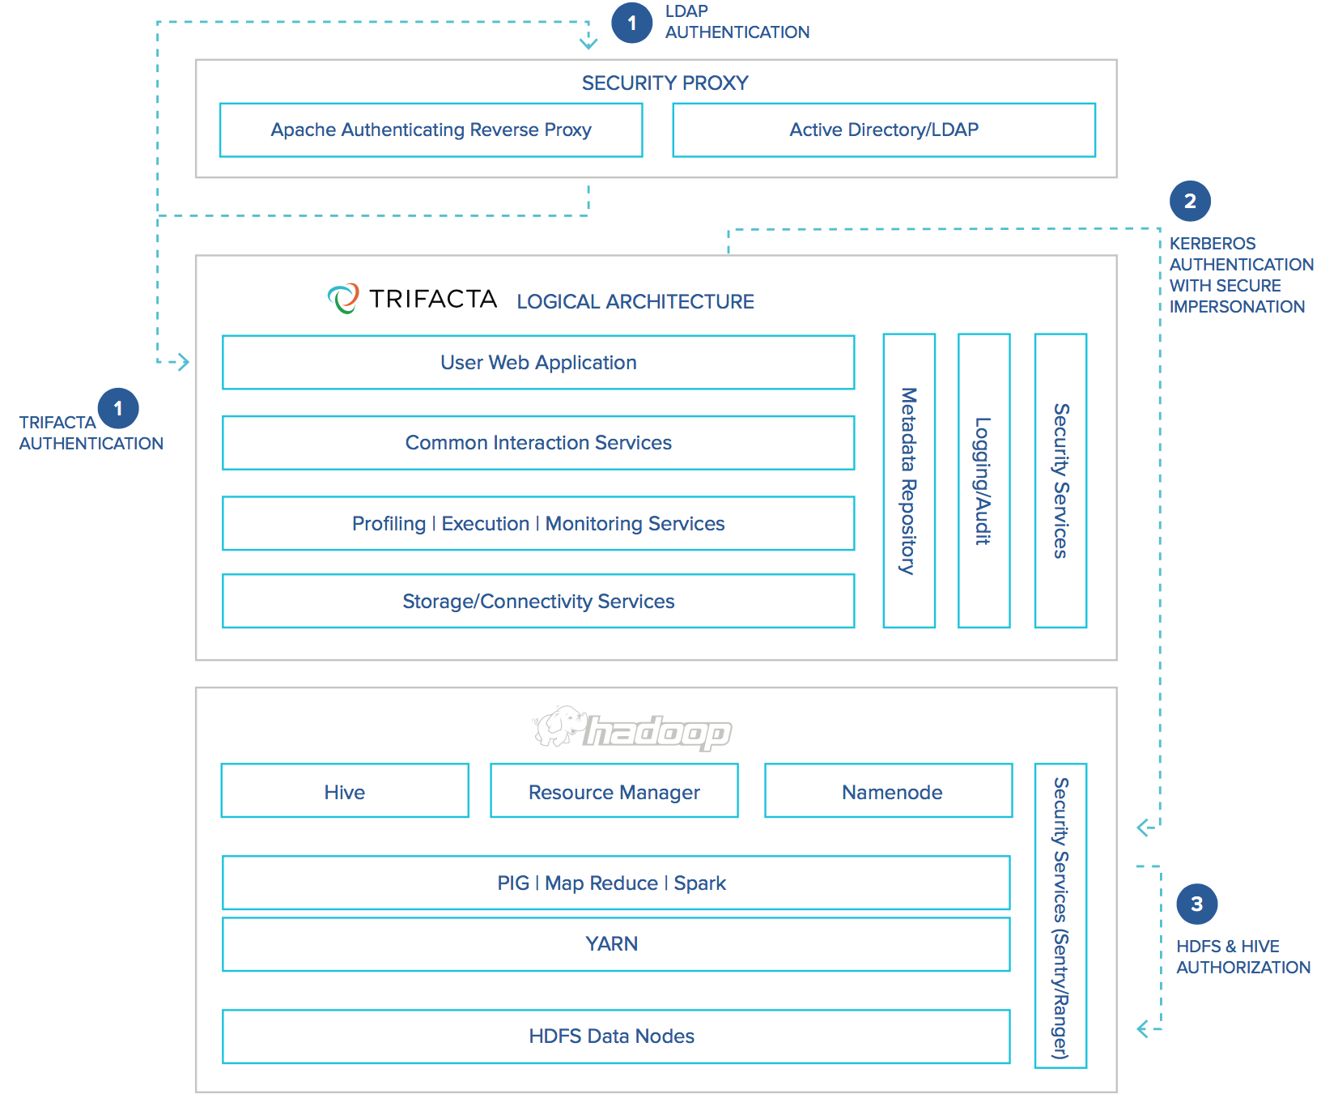
Integration with Hadoop

Slide 15
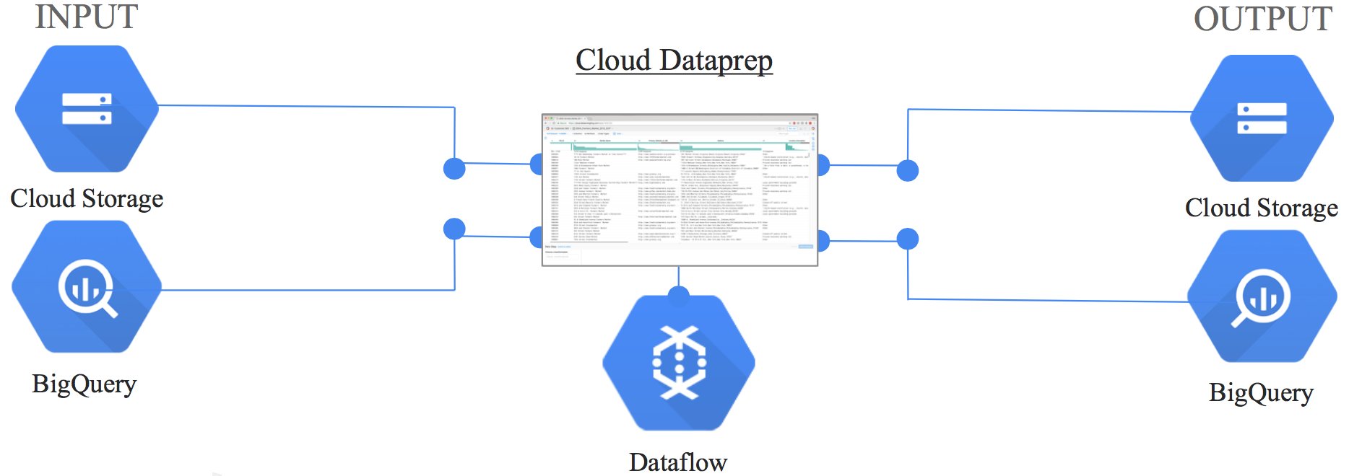
Integration in Google Cloud Ecosystem
Trifacta Interface & Photon Engine Integrated within Google Cloud Ecosystem
Access & publish data from/to Google Cloud Storage & BigQuery
Compile recipes to Google Cloud Dataflow for fully-managed auto-scaling execution

Slide 16
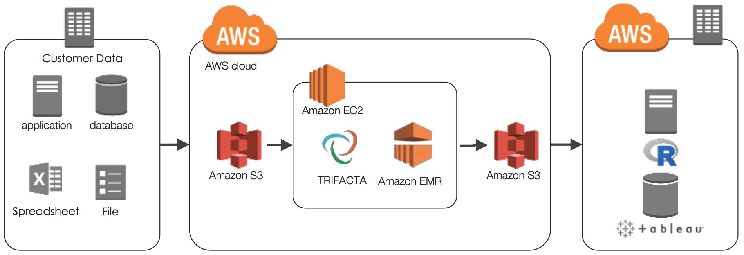
Trifacta Architecture on AWS

Slide 17
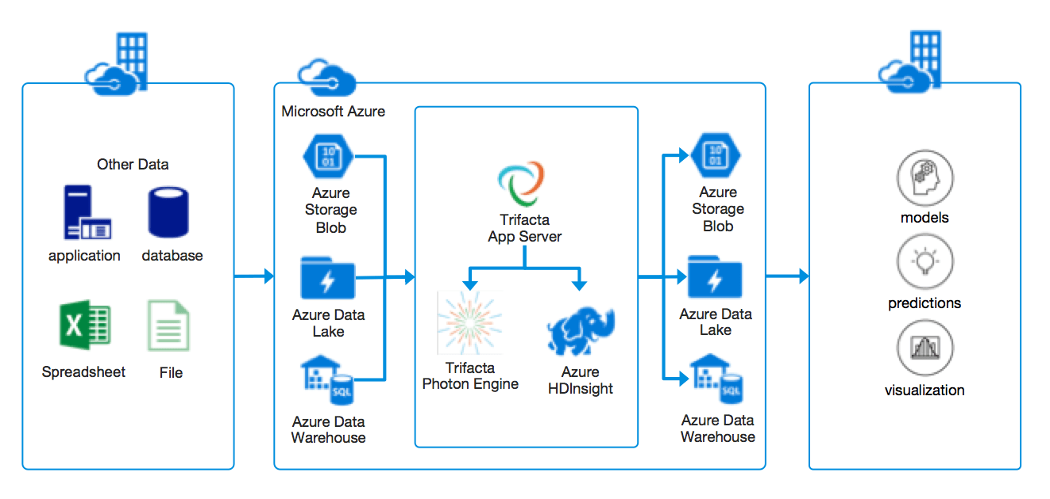
Trifacta Architecture on Microsoft Azure

Slide 18
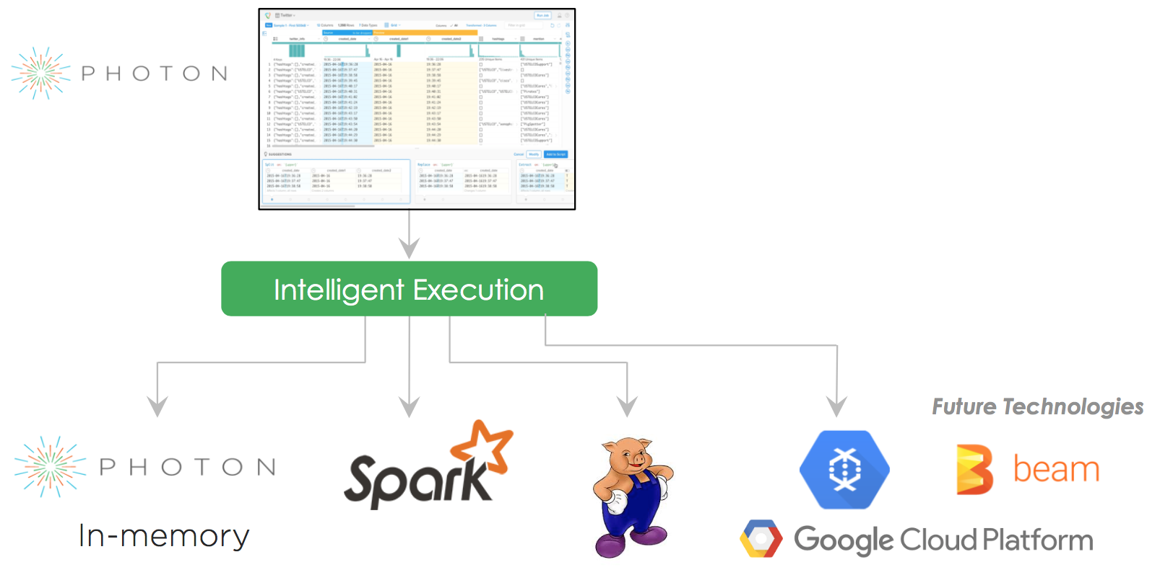
Execution engines

Slide 19
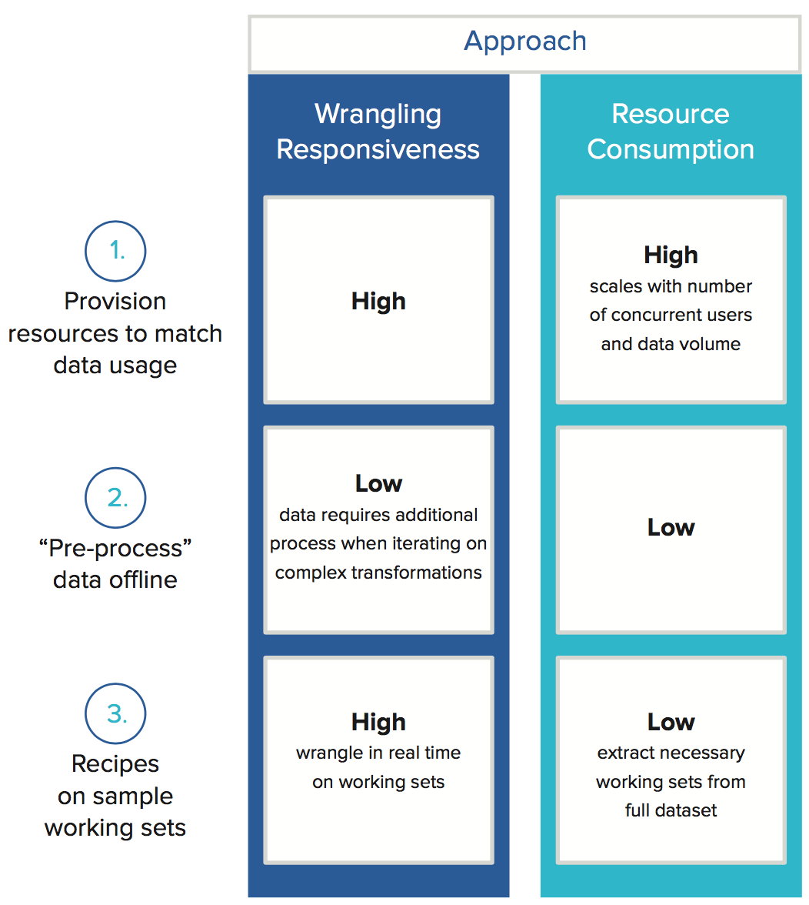
Technical Approaches to Anyscale Interactivity

Slide 20
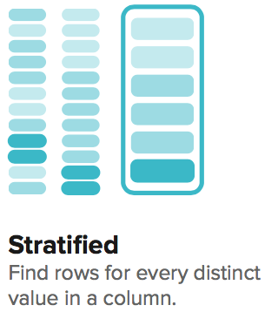
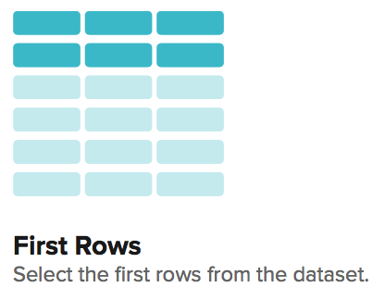
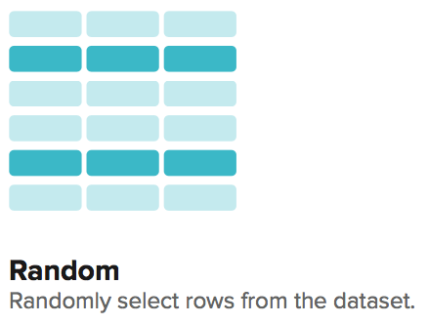
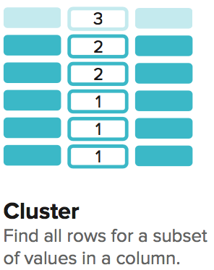
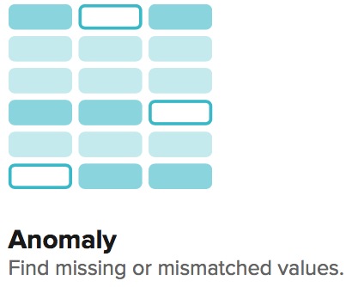
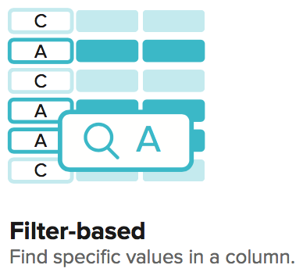
Sampling strategy

Slide 21
Demo scenario
Input Data – Transactions from sales system, customers, zip codes:
Product
Location
Date/Time
Price
Quantity
Goal of the analysis
Combine transaction data from multiple year files
Join the data with reference datasets
Perform a lookup to fill in missing state values
Filter data by date
Aggregate prices by product and zip code

Slide 22
DEMO
Sample demo

Slide 23
Trifacta benefits
Empower the people who know the data best
Accelerate time to value
Lower business risk with more accurate data
Unlock innovation using a wider variety of data

Slide 24
Useful Links
Trifacta resources:
Product Documentation
Product editions spec.
Resource library
Online training
Product on Azure Marketplace
Product on AWS Marketplace

Slide 25
Q&A

